Slide 1
MEMBERSHIP MEETING 2021

Slide 2
SCLA MISSION
A shared responsibility to preserve and protect the Spider Chain of Lakes for future generations

Slide 3
Agenda
1) Election of New Board Members
review of process, nominations, vote
2) Association Update
Membership; Lynn Kane
Communications; Martha Coventry
Aquatic Invasive Species Committee; Larry Keller
Philanthropy; Wendy Wood
Finance; Brad Schmidt
3) Questions; Lili Herbert

Slide 4
Photo by Kris Dew

Slide 5
Election of New Board Members
Review of Process
Board Advisory Team works to find people to fill board slots
Nominees are considered by the board
Slate of proposed nominees brought to membership for vote
Nominations may also be made from the floor at meeting
Members serve three year terms and may serve an additional term
Bylaws require no fewer than 3 and no more than 9 members

Slide 6
SCLA Board of Directors
Current 20-21 | Term ends May of: | Proposed 21-22 | Term ends May of:
Lili Herbert | 2023*
Lynn Kane | 2023 | Lynn Kane | 2023
Jerry Keating | 2023 | Jerry Keating | 2023
Larry Keller | 2023 | Larry Keller | 2023
Deb Amery | 2022 | Gina Blayney | 2022
Martha Coventry | 2022 | Martha Coventry | 2022
 |  | Jay Hoeschler | 2022
Dan Connolly | 2021* | Wendy Wood | 2024
Alex Farrell | 2021 | Alex Farrell | 2024*
Brad Schmidt | 2021* | Kathy Schmidt | 2024
 |  | Lili Herbert Past President | January 2022
 |  | Dan Connolly Past President | May 2022

Slide 7
Nominee: Gina Blayney
History with Spider Lake and SCLA
Over the past 14 years, Gina’s SCLA volunteer efforts include co-chairing the annual Spider Lake picnic and serving on the membership/events committee. She and her husband have been members of the association since they bought their home on Big Spider 14 years ago and are major contributors to the SCLA endowment.
Relevant Experience
Gina recently retired after 15 years as President and CEO of Junior Achievement of the Upper Midwest, an education nonprofit. She has extensive experience with partnership development, program implementation, governance, marketing, and fundraising. Education, youth development and the environment are all issues she cares deeply about.
Interest in serving on SCLA Board
Gina has a strong interest in preserving Spider Lake’s pristine eco-system, forging friendships, and building a community for future generations.

Slide 8
Nominee: Jay Hoeschler
History with Spider Lake and SCLA
Jay and his wife Judy call Spider Lake home. They have worked to ensure regulation of shoreland to preserve the Spider Chain of Lakes’ natural habitat and watershed. They have worked with SCLA’s SLEEK program, held at their property on Four Pines, and also helped with SCLA’s 4th of July activities.
Relevant experience
Jay has extensive board, business, and strategic thinking experience. He is President and owner of Hoeschler Corporation, specializing in real estate development and property management. He has served on many boards (UW La Crosse Foundation, St. Francis Medical System, Mississippi Valley Conservancy, YWCA La Crosse, and many others.)
Interest in serving on SCLA Board
Jay sees SCLA as a great organization with a very critical mission to protect and preserve our chain of lakes, and wants to serve on the board to continue that level of service.

Slide 9
Nominee: Kathy Schmidt
History with Spider Lake and SCLA
Kathy is married to Steve Schmidt, whose family bought their cabin on Big Spider in the 1930s. They have spent vacations on the lake for the past 40 years. Since retiring in 2015 they have spent 3-4 months per summer on the lake. Kathy has served as a Lake Monitor, volunteered at the picnic, and joined the Finance Committee in November of 2020.
Relevant experience
Kathy has served on two non-profits boards, was treasurer of the local Boy Scout troop, volunteered extensively in schools and Sunday school, and owned her own yoga studio for 10 years employing 3 contract workers. Kathy worked for Kodak for 17 years as a software engineer/software development manager, a market development manager, and a product line manager.
Interest in serving on SCLA Board
Kathy now has the time and energy to serve on the SCLA board. The Spider Chain is her “happy place”. She values the pristine waters and forests and wants to do her part to preserve these resources for our children and, now, our grandchildren.

Slide 10
Nominee: Wendy Wood
History with Spider Lake and SCLA
Wendy and her husband Steve Smith have been very active members of SCLA for many years. Wendy’s experience includes serving as the Investment Committee Chair since 2014, chairing the Philanthropy Committee from 2015-2018, and serving on the Membership Committee from 2013-2018..
Relevant Experience
Wendy retired in 2014 after a career in finance and investment management, the last 20 years in the endowment and foundation community, where she co-managed investment portfolios of $2 to $6 billion. She created and managed a wide array of structured (planned) gifts as well as policies and procedures for gift acceptance, management and risk assessment. Wendy has served on numerous foundation boards/committees, including JDRF International, Lourdes Foundation, Ronald McDonald House, Destination Medical Center Economic Development Agency, and the Poverello Foundation.
Interest in serving on SCLA Board
Wendy would like to serve on the SCLA board of directors to help it continue to adopt best practices to advance its mission.

Slide 11
Proposed Slate of Board Nominations
Gina Blayney (Term ending May 2022)
Jay Hoeschler (Term ending May 2022)
Kathy Schmidt (Term ending May 2024)
Wendy Wood (Term ending May 2024)
Alex Farrell (Second term ending May 2024)

Slide 12
Larry Keller: SCLA President
Involved with SCLA since 2014:
AIS Committee Vice Chair
Coordinated (with wife Katie) the Yellow Flag Iris Project
Started (with Katie) the native plant sale, now in its third year
Board member
Relevant experience/background:
BS and MS in Chemical engineering; MBA
Responsible for environmental standards at Polaris Industries
Commitment to SCLA mission
Wisconsin Lakes Partnership Lake Leaders Program participant

Slide 13
Photo by Steve Schmidt

Slide 14
Membership Committee Update, Lynn Kane

Slide 15
SCLA Membership
Year | Number of Members | Lapsed Memberships
2017 | 165 | 67
2018 | 210 | 41
2019 | 215 | 45
2020 | 223 | 29
Of the 223 SCLA Members, 175 are property owners and 48 are family/friends
40% of SCLA Members joined at a tiered level in 2020
There are 260 property owners who are potential members; 67% were SCLA members in 2020

Slide 16
Communications Update, Martha Coventry

Slide 17
SCLA Communications
Spider Lines
Our SCLA electronic newsletter
Spider Lines is sent to SCLA members (about 330 people) in April and October
All Spider Lines since 2007 are available on the SCLA website: spiderchainoflakes.org
We welcome your ideas for topics to cover. Please email them to: Martha Coventry at coven002@umn.edu

Slide 18
Monthly Updates
Monthly emails with timely information for SCLA members
SCLA Website
spiderchainoflakes.org
Interested in redesigning and/or managing the site? Please contact Martha Coventry at coven002@umn.edu
SCLA social media
SCLA has a Facebook page. Click on the Facebook icon at the bottom of the SCLA website homepage.

Slide 19
Photo by Dan Mersel

Slide 20
Aquatic Invasive Species Update, Larry Keller

Slide 21
Aquatic Invasive Species Committee – 2021 Active Programs
Landing Monitors
First Line of Defense against AIS
Incoming & outgoing boat inspections – 2,752 in 2020
Clear Lake & Heinemann’s landings
SCLA’s single largest expense @ $24k/yr total
Shared cost - WDNR Clean Boats Clean Waters Grant
Lake Monitors
The coronavirus has not stopped our due diligence in protecting the Spider Chain !
100% volunteer network
Twice-per season inspections looking for new AIS
All five lakes were monitored in 2020 by 42 people with just under 100 volunteer hours.
AIS Management
Yellow Flag Iris removal coordination – contractor support experiment in 2021 – new !
Purple Loosestrife containment
Curly Leaf Pondweed bed monitoring
Keeping Eurasian Milfoil and Zebra Mussels out
Special Projects
3rd Annual Native Plant Sale – orders due June 7th
Project Pike – Memorial Day weekend & summer - long event – new !
Lake Water Testing – new WI Citizen Lake Monitoring Network volunteer !
Comprehensive Lake Management Plan – WIP
NATIVE PLANT SALE
AIS Committee is Lead by Ray Langer – 8 Members Strong & Active

Slide 22
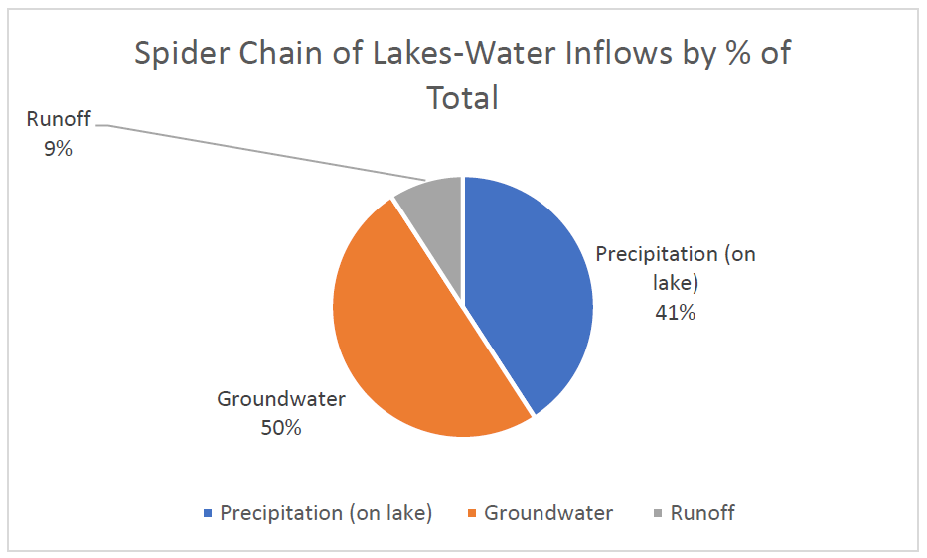
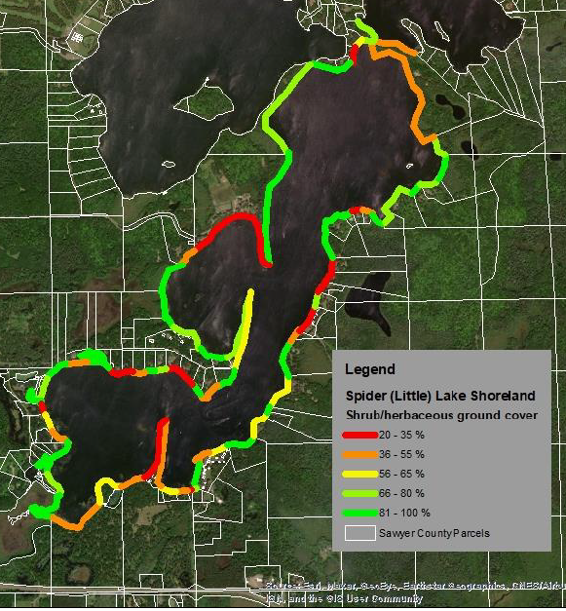
Comprehensive Lake Management Plan (CLMP)
A Road Map for the Health of Our Lakes
This project will develop a comprehensive lake management plan to address water quality, aquatic plant management, lake habitat, and other management and social considerations for the long-term health of the Spider Chain of Lakes.
A WDNR grant of $21,529 was approved by WDNR in Feb 2020. Advance payment has been received and work is underway.
✓
✓
✓
The 3 Main Data Inputs Are Now In Place
1
2
3
Next Step = Implementation Plan Meetings July-September – Open to Interested SCLA Members

Slide 23
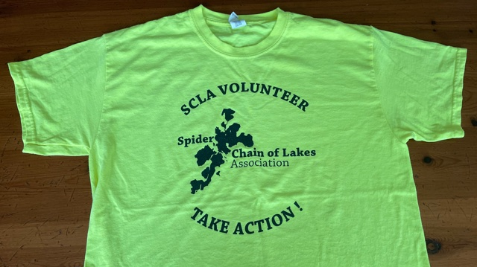
On Behalf of the AIS Committee Members
Ray Langer, Chair
Candy Ramsay
Marv Ramsay
Tim Sheldon
Dave Meyer
Steve Salisbury
Dave Mickelson
Larry Keller
+ 42 Lake Monitor Volunteers
We’re always looking for new talent !
Contact one of us if you’re interested in joining
Let us know if you want to participate in the CLMP planning meetings to be held July - Sept
Thank You for Your Support

Slide 24
Philanthropy Update, Wendy Wood

Slide 25
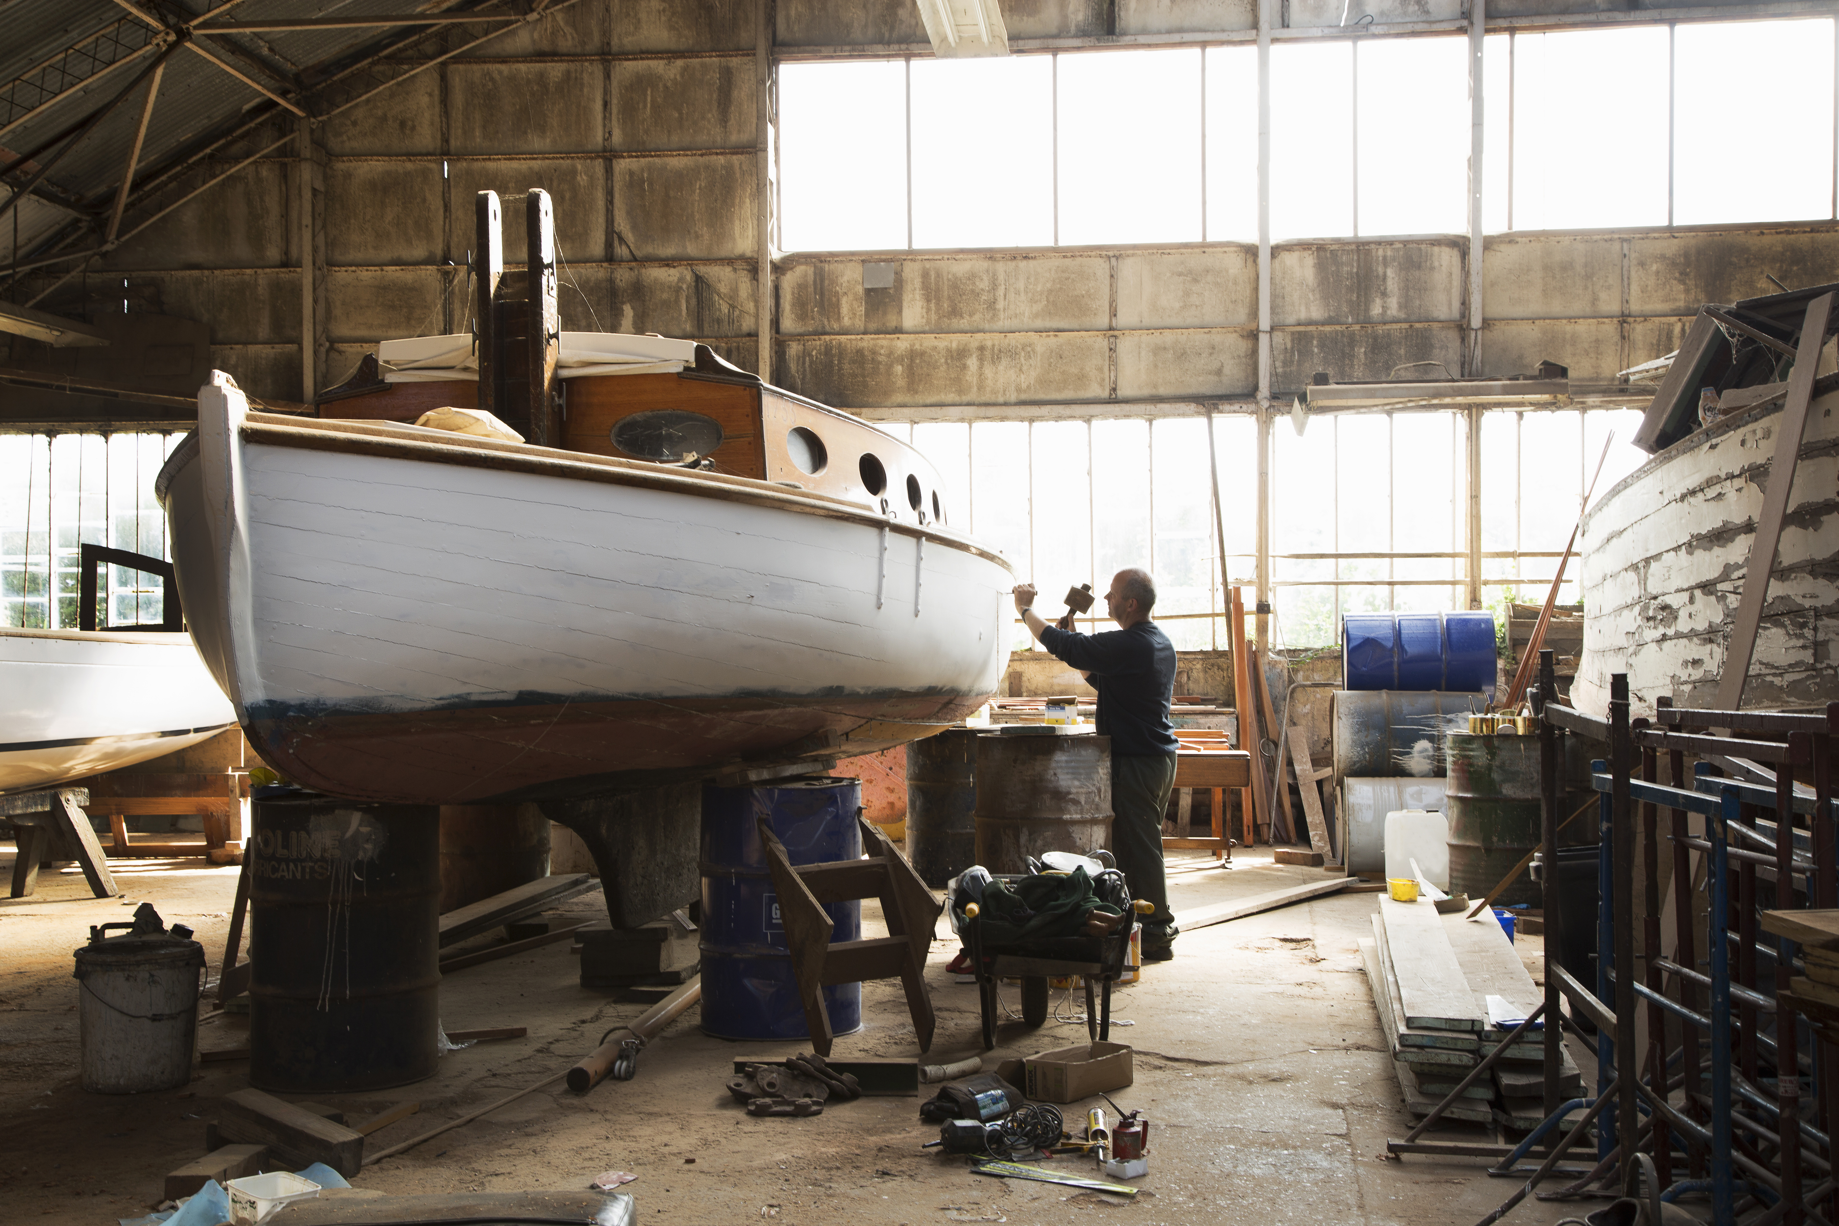
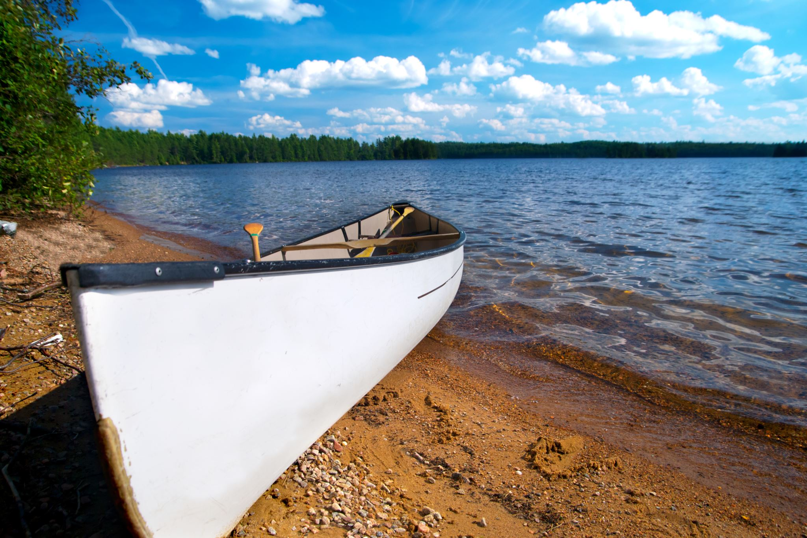
SCLA PHILANTHROPY - $1.2 MILLION GOAL
Endowment $800K
Emergency Reserve $400K
Notes:
2014: BOD $1.2 Million campaign launched in 2 parts:
ENDOWMENT $800K
EMERGENCY RESERVE $400K
Purpose: To provide a sustainable financial model to fund mission activities
Endowment To Serve in Perpetuity with annual draw ~ to cover up to 50% of annual expenses
Emergency Reserve to maintain at least $300K for EWM / other AIS mitigation + $100K if needed to augment budget
Emergency Reserve was not to be used for administrative expenses – AIS only

Slide 26
Notes:
SO, HOW DID WE DO? IS IT TIME TO CELEBRATE?
2 Part Answer:
PART 1. “VERY GOOD!” Yes, (Celebrate). YAY US! And THANK YOU TO ALL Benefactors who made this possible!
As of Dec. 31, 2020: ~$895,000 Collected (79% of Goal)
We have done exactly what we told you we would do: Put processes and best practices solutions in place to manage the endowment and the Emergency Reserve Funds, so as donations flow in, we are following a disciplined process and are on the way to a SUSTAINABLE FINANCIAL ORGANIZATION

Slide 27
ORIGINAL GOAL: $1.2 Million ($180K Short)
Notes:
PART 2. WE STILL Have a GAP with our original goal (WE NEED TO RAISE $180,000 to meet Goal)
In 2017addition – FISH TIER MEMBERSHIPS introduced to create current cash flow (above DNR limit of $50/year)

Slide 28
Gifts $895K + Fish Tiers $64K
Notes:
In 2016 we transitioned from a “Fundraising Campaign” to an “Annual Giving Program” to keep donations flowing, AND
2017: ADDED FISH TIER Memberships
Gifts Embedded in Fish Tiers: 2017-2020: $64,000 (used for current expenses)
We now have over 100 members in FISH TIERS
We now have current cash flow that is meaningful (we hope it is sustainable!)
Exel Source Document:
SCLA PHILANTHROPY/PC PRESENTATIONS/PHIL HISTORY + Annual Reports/ ANNUAL REPORT PC Charts + Data(Exel).xlsx

Slide 29
PROJECTED FUNDING GAP FY 2021: 16%
Notes:
We still have a funding gap.

Slide 30
We are almost there (But not quite)
$180,000 EMERGENCY RESERVE
ANNUAL TIER MEMBERSHIPS CRITICAL
AND ~$10,000 - $20,000 TO “BALANCE THE BUDGET”
Notes:
Our MISSION to PRESERVE & PROTECT the lakes
THREAT is Growing each year – we are surrounded by lakes with EWM
Each year 200-300 boats enter Spider Chain of Lakes; many have been in other lakes within 5 days of launch here
OUR MISSION is greater today, and the need for a SUSTAINABLE FINANCIAL MODEL is great. If we wish to expand our spending on mission we must grow the Endowment and Emergency Reserve Funds.
Thank you for your help in getting us closer to a sustainable financial organization!

Slide 31
Photo by Stephanie Berl

Slide 32
Finance Update, Brad Schmidt

Slide 33
Financial Position at December 31, 2020
Total Assets and Net Worth 2020: $1,083,645
Unrestricted cash available for Operations: $71,863
Investments and restricted cash: 1,012,948

Slide 34
2020 Net Revenue & Expense Highlights
Total net revenue over expenses: $204,540
Net income from Investments earnings and Contributions: $187,465
Net income from operating activities: $17,075
Income from operations included:
$34,626 in tiered donations and membership dues
$24,571 in grant revenue for current and future projects, including three year comprehensive lake management plan
AIS expenses of $31,540, including $24,129 for boat landing monitors

Slide 35
Looking Forward
Budget for 2021 and five year projections are looking solid:
Anticipate a net loss from operating activities in 2021
Projected loss a function of continued expenses related to the 3 year lake management plan, largely funded by grant recognized as revenue in the 2020 operating surplus
Five year projected financial results are balanced
Future reliance on available spending from emergency reserve can be avoided with continued success and support of the tiered donations program (THANK YOU!)
Transition to new Treasurer has been underway since beginning of the year to assure smooth transition

Slide 36
Photo by Richard Trenkmann

Slide 37
2021 Events
Date | Event
June 12 | Plant Sale Pick Up
June 13-20 | My Shoreline Week
CANCELLED due to COVID risk | SLEEK
July 4 10:00 a.m. | Boat Parade
September 5 4:00-7:00 | SCLA Annual Picnic

Slide 38
Questions

Slide 39
THANK YOU for your support of SCLA!
To get involved, contact: SpiderChainofLakes@gmail.com
We’ll find a place for you!

